Slide 1

North of Oxford Corridor Schemes
A44/A4260
Briefing
Project Team
Jacqui Cox - Infrastructure Locality Lead Cherwell
Roland Jordaan – Project Manager
Eric Stevens – Senior Transport Planner
Adil Mohammad – Project Technical Lead
James Rossi – Senior Transport Planner

Slide 2

Agenda
Introductions | Jacqui
Background | Jacqui
A44 Cassington Road to Loop Farm
Peartree Interchange
Kidlington Roundabout
Feedback & Discussion
A.O.B
Notes:
There is around 10 minute discussion on each scheme

Slide 3
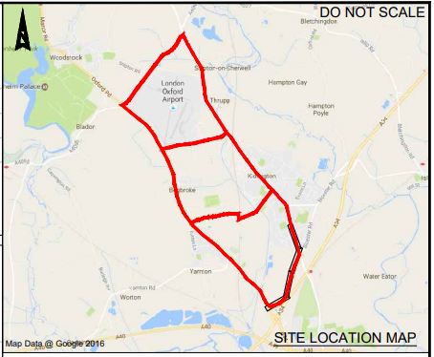
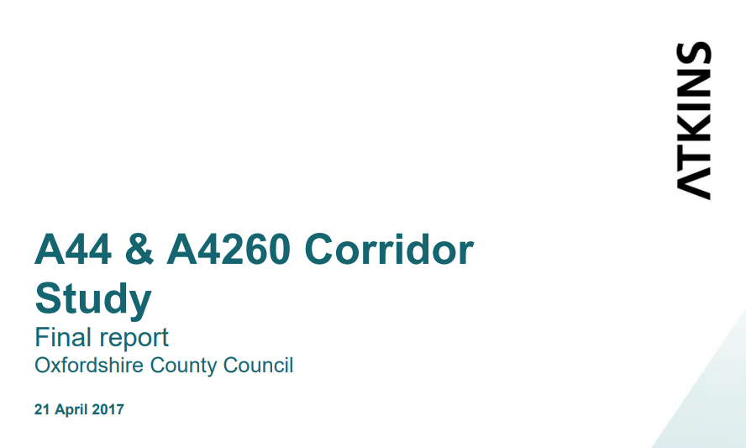
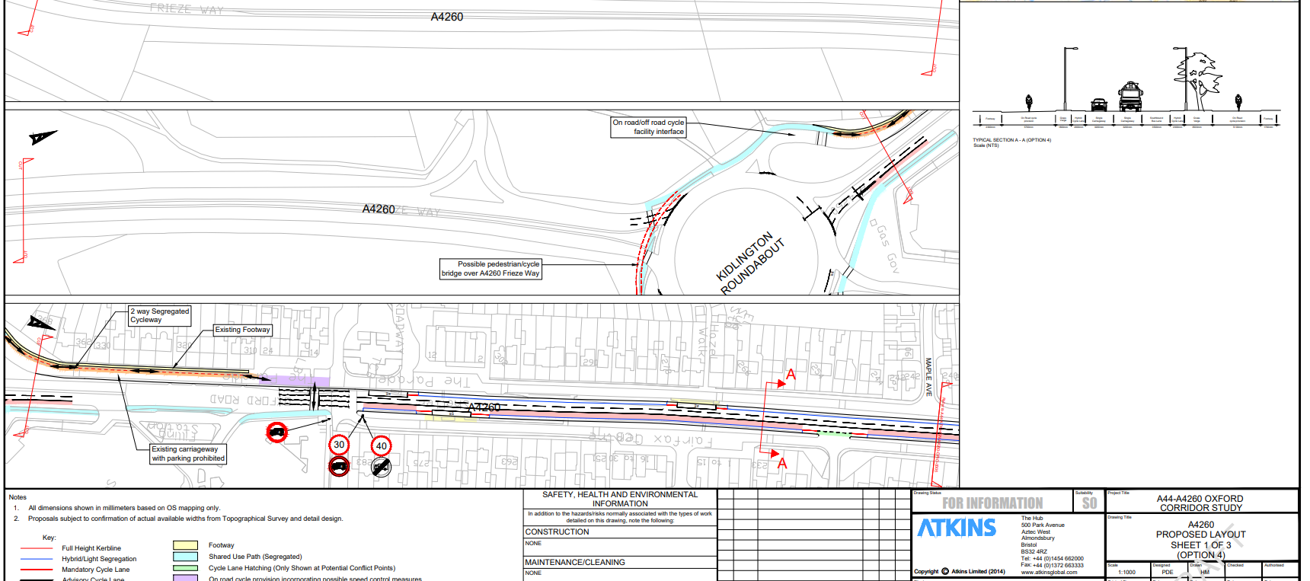
A44/A4260 corridor study
Notes:
In 2016/17 Atkins were commissioned to undertake a study of the A44 & A4260 corridors and key cross links between Upper Campsfield Road (north of London Oxford Airport) and Frieze Way/ Peartree Interchange. The study built upon objectives set out in the Oxfordshire Local Transport Plan (LTP) – to provide high quality routes for rapid transit, bus, cycle and pedestrian journeys. This study considered the feasibility of options and priority measures throughout the corridor to provide an overall concept design to deliver the LTP objectives.

Slide 4
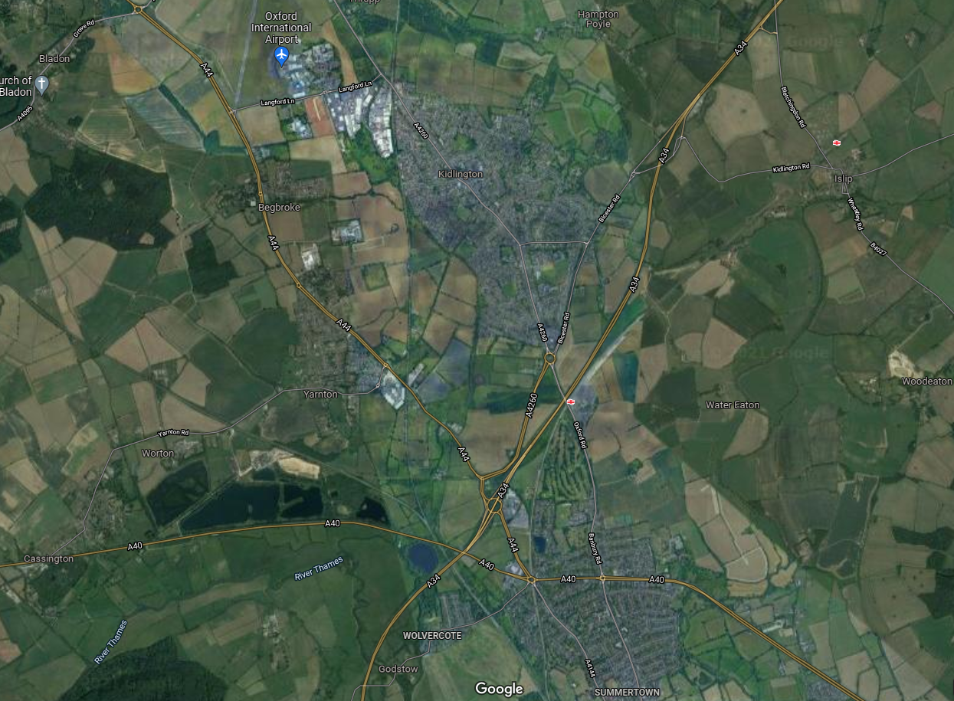
Background
Kidlington Roundabout
A4165 between A4260 and A40
Loop Farm to Cassington Roundabout
Peartree Interchange & Loop Farm Roundabout
A40 Oxford North
Notes:
Growth Deal Funding was allocated and enabled us to carry out options assessments along the whole A44 corridor and at Kidlington roundabout down the Oxford Road to Cutteslowe roundabout – southbound bus lanes and cycle facilities for both corridors. The funding also enabled feasibility design work on A44 from Cassington roundabout and Kid r’bout to Cutteslowe. And GD is now enabling delivery of the A44 … and Kid r’bout. Other sections will either be directly delivered by developers or through s106 contributions.
The priority and focus of today’s briefing concerns the elements that OCC is delivering – A44 Cassington r’bout to and including Peartree Interchange and the Kidlington roundabout.

Slide 5
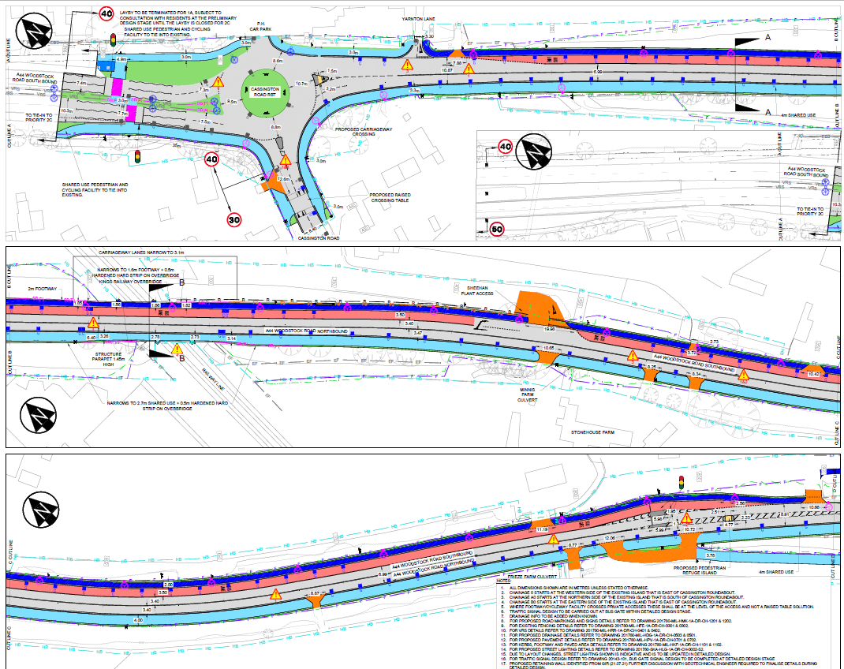
Loop Farm - Cassington Roundabout
Notes:
At the northern section, the design features a formal shared Toucan crossing of the A44. A raised table is proposed as both a traffic calming feature when entering Yarnton and as a crossing point.
Shared use paths will be widened utilising existing highway verge to provide a width of 3.0m in constrained areas. Elsewhere the width is 4.0m.
Moving southward, a 3.5m wide bus lane is created with 2m footway on the eastern side of the carriageway. Traffic lanes measure c.3.5m. The bus lane breaks to allow access/egress to Sheehan Haulage and Plant before continuing southward.
Width constraints at the bridge over the Oxford canal see the bus lane terminate and buses join general traffic for around 150m before a bus lane resumes southward. Pedestrians are guided to the shared use path on the southern side of the A44 making use of the canal towpath.

Slide 6
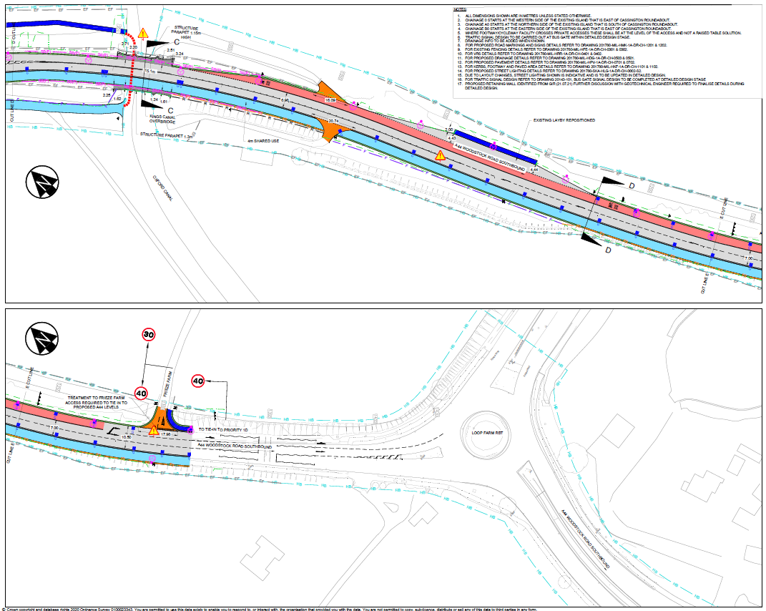
Loop Farm - Cassington Roundabout
Notes:
Pedestrians are guided to the shared use path on the southern side of the A44 making use of the canal towpath. The bus lane continues south and the existing layby that is removed in creating the bus lane is repositioned. The bus lane terminates allowing for two lanes on the approach to Loop Farm roundabout opening up to three at the entrance to the roundabout as part of Works. This is an improvement on the existing arrangement where this is a relatively short section of two lanes + flare.

Slide 7
Loop Farm – Cassington Road
Summary:
Scheme will provide a southbound bus lane along the A44 to improve journey time reliability and incentivise bus travel into the city.
Existing shared use paths are widened to provide a safer corridor for walking and cycling.
Speed limits are reduced from 50mph to 40mph.
Stage: Preliminary Design Complete. Detailed Design about to commence
Cost Allocation: £16.2m (Inc. P1D) funded by Growth Deal
Construction Start Date: Aug 2022

Slide 8
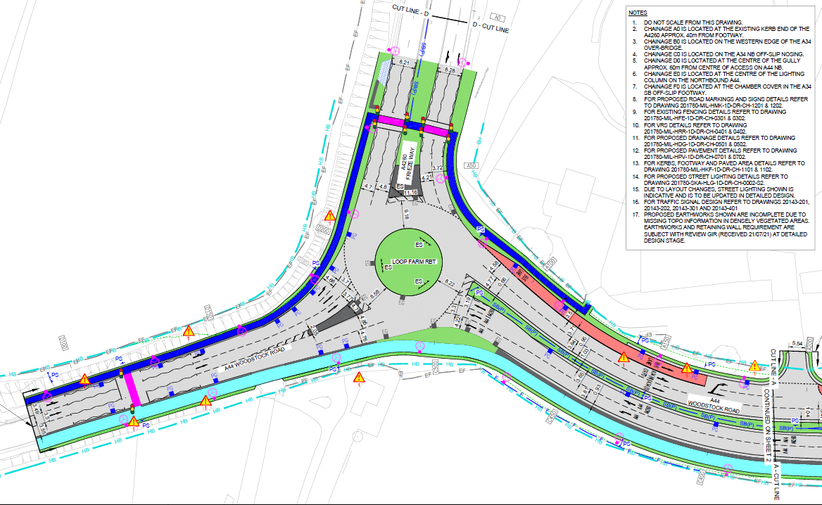

Peartree Interchange – Loop Farm Roundabout
Loop Farm Roundabout
Notes:
A 2m wide footway is provided between Frieze Farm towards Loop Farm roundabout with a pedestrian crossing facilitating movement to the south. Entries are widened and the two lane approach along the A44 Woodstock Road is lengthened.
On A4260 Frieze Way, a two stage inline crossing is proposed that is far safer than the uncontrolled use of the roundabout splitter island Speed limits on all approaches are to be lowered to 40mph rather than current NSL restrictions.
A southbound bus lane forms to the south of Loop Farm roundabout and continues towards Peartree Interchange.

Slide 9
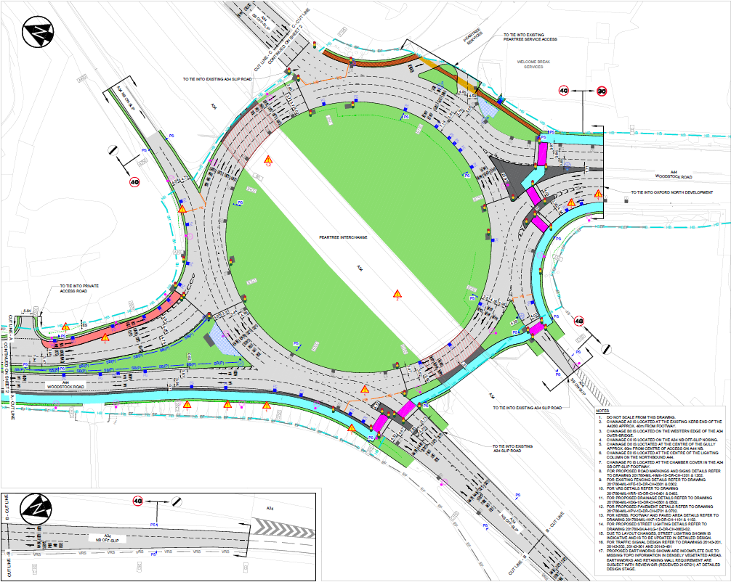
Peartree Interchange – Loop Farm Roundabout
Peartree Interchange
Notes:
The bus lane continues and is provided with a dedicated approach lane to Peartree interchange which is proposed to signalised.
The current three lane circulatory on the northern side of the interchange is widened to four allowing an additional lane to be signed for Oxford (A44). Beyond this, 3 lanes are proposed (2 for A34S).
The current two lane arrangement on the southern side of the interchange is widened to three lanes with the central lane signed for both A44N and A34N. Further round and completing the circulatory there are four lanes in place of the current two lanes. Two will be signed for A34N (the latter inc. services) and the remaining lanes for Oxford.
In terms of slip roads, two lanes will be provided from A44 S to A34 SB On slip rather than one currently that yields to circulatory flow. There will be an additional A34NB exit slip to allow two lanes to turn left rather than the one currently.
NMU provision is concentrated around the south of the interchange. The A34 NB off slip is a current barrier to movement and so a two stage Toucan crossing is proposed across the four lanes. The existing shared use path under the A34 is to be widened and a signalised crossing provided across the A34 SB on slip. The shared use path will tie into works delivered under the Oxford North development. A further 3 signalised crossings are provided to cross 7 lanes of traffic in accessing the eastern shared use path and footpath to the Peartree services.

Slide 10
Peartree Interchange – Loop Farm Roundabout
Summary:
Scheme will provide a southbound bus lane on the A44N approach to Peartree Interchange.
A combination of widening the circulatory and modifying entries and exits on the approach to Peartree Interchange will secure the performance of this junction in the future for the benefit of all users.
Existing NMU provision is to be improved with wider shared use paths and provision of new signalised crossing facilities.
Speed limits are reduced from 50mph to 40mph.
Stage: Preliminary Design Complete. Detailed Design about to commence
Cost Allocation: £16.2m (Inc. P1A) funded by Growth Deal
Construction Start Date: June 2022

Slide 11
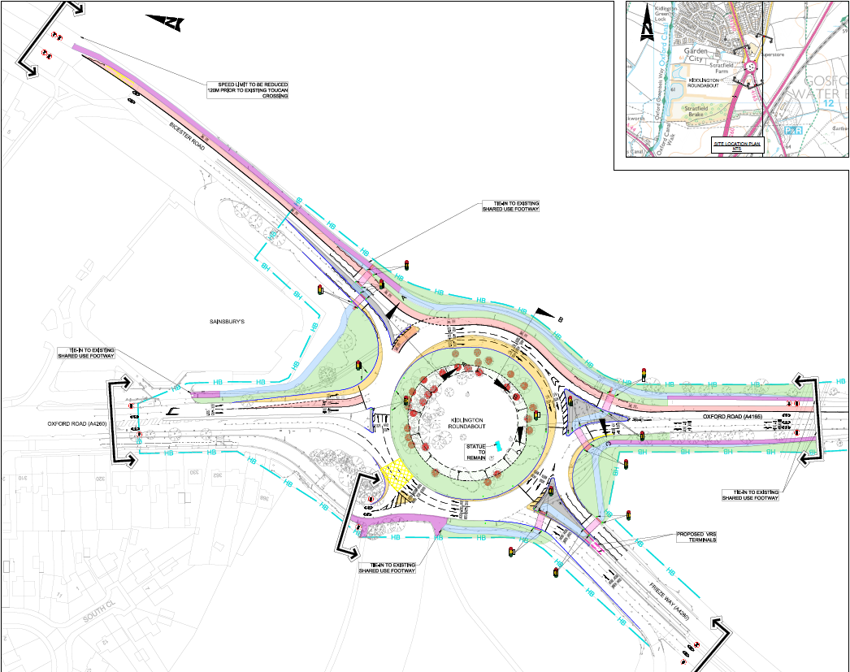
Kidlington Roundabout
Notes:
Proposals comprise construction of a bus lane on Bicester Road 250m in advance of the roundabout. This will connect with the existing bus lane on the roundabout that continues onto Oxford Road A4165.
The current three lane entry into the roundabout from Frieze Way will be downgraded to two lanes through building out the kerb line. This reduces the crossing distance for pedestrians/cyclists in accessing the central splitter island and this crossing will be signalised.
The Oxford Road A4260 N approach will be modified by converting the central lane on the approach to the roundabout into a bus lane and widening the nearside lane to allow for left turning movements only. This provides buses with a dedicated space when entering the roundabout in place of the bus and left turn movement only. Buses are guided into the bus lane on the roundabout by a short section of bus lane.
The eastern circulatory is widened utilising the central island to provide space for three lanes and the bus lane rather than the current two lanes and bus lane.
The roundabout currently lacks lane markings contributing to poor lane discipline. These will be provided under the proposals and all arms other than the Oxford Road will be signalised.
Signalised crossings will be provided on the Bicester Road, Oxford Road South and Frieze Way Arms to provide safer crossing facilities for NMU’s in place of the existing roundabout splitter islands.

Slide 12
Kidlington Roundabout
Summary:
Scheme will provide a southbound bus lane along Bicester Road connecting with bus lane on Kidlington Roundabout.
Improved infrastructure for buses on the A4260 SB approach as left turns are separated from buses.
Signalised crossings are proposed to provide safer access for NMUs across the roundabout.
Stage: Preliminary Design to commence
Cost Allocation: £6.0m funded by Growth Deal
Construction Start Date: September 2022

Slide 13
Feedback & Discussion
A.O.B
Notes:
General point of tree/vegetation clearance to allow survey work on P1A and P1D. Compensatory tree planting in areas of loss due to works to be determined at detailed design stage.
OCC website will host details and plans. Aim for this to be available by end of November 2021.
Consultants will undertake scheme review to check against LTN 1/20 requirements. Minor tweaks may result where betterments can be identified.

